Slide 1
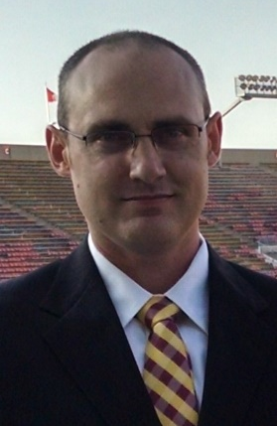
Computer Vision w/ Raspberry Pi
Setting up a Raspberry Pi for image processing
Evan Hennis
Google Developer Expert in Machine Learning
@TheNurl
https://eckronsoftware.wordpress.com
https://github.com/ehennis
YouTube: Evan Hennis

Slide 2



Bio
BS from Iowa State 2004
MS from Georgia Tech 2018
C# developer since 2004
GDE in Machine Learning 2019

Slide 3
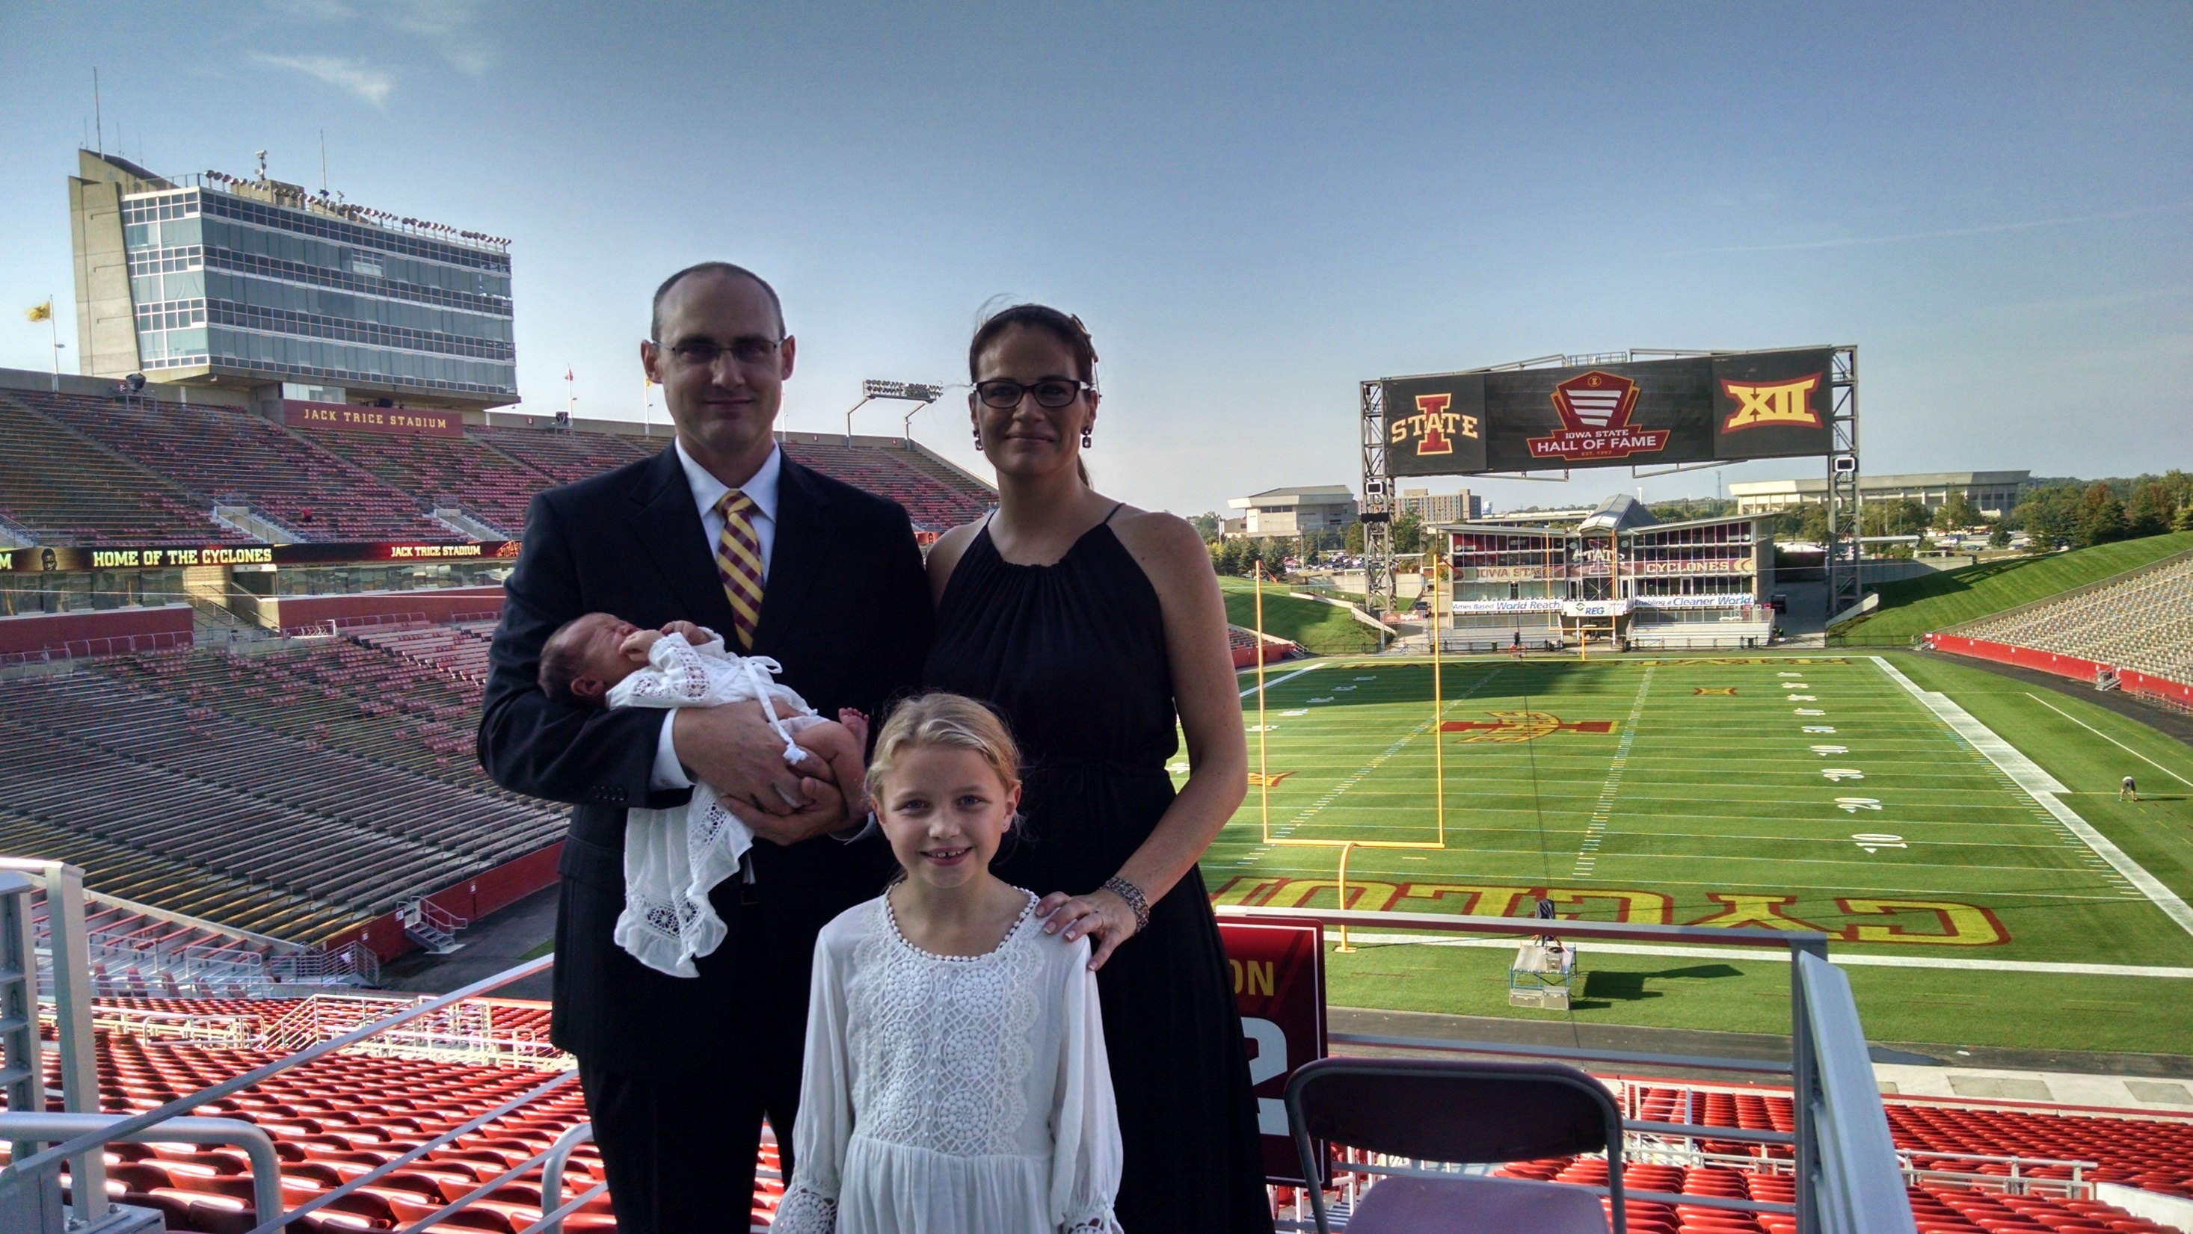

Slide 4
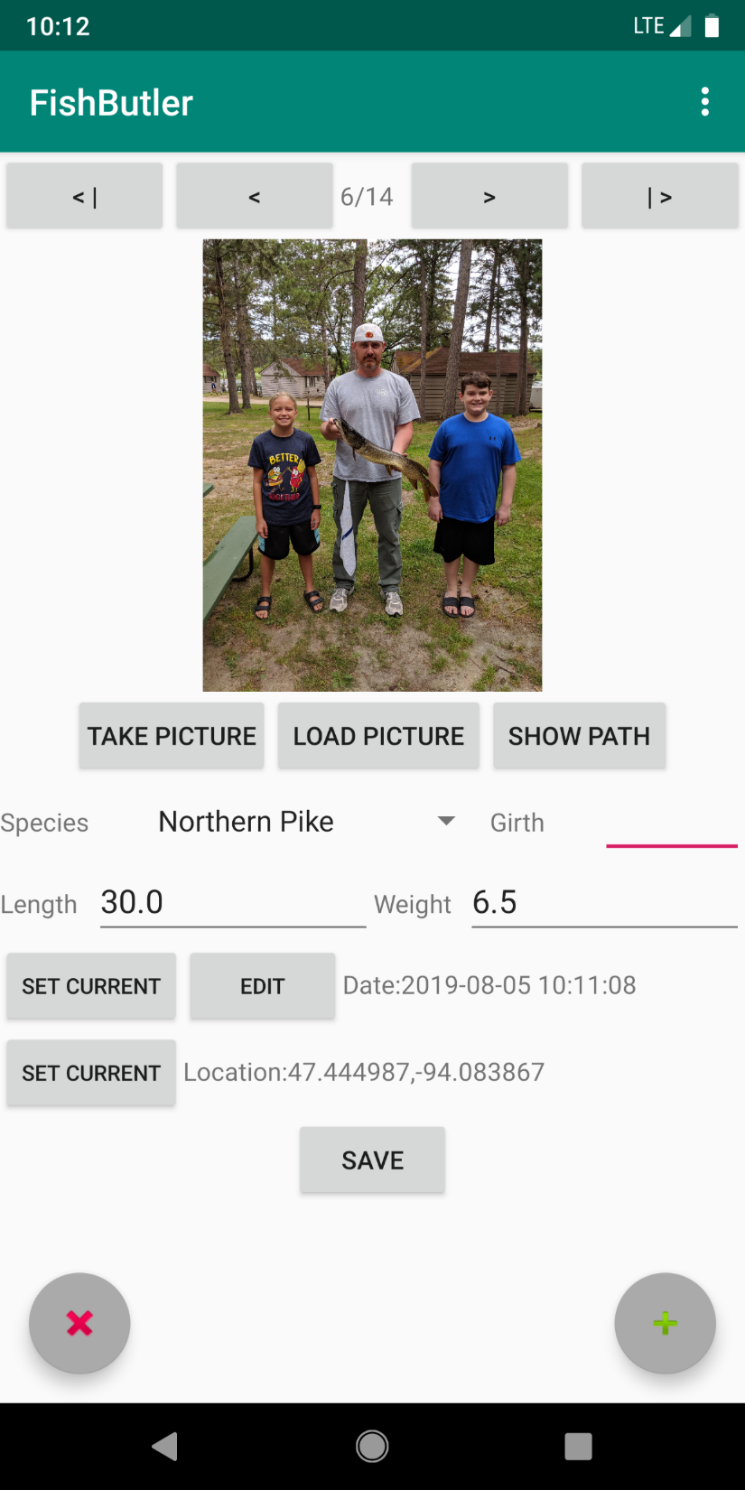
Fish Butler
Written this summer with my daughter (11) and my nephew (13)
https://play.google.com/store/apps/details?id=com.eckronsoftware.fishbutler

Slide 5
Using Deep Learning to Predict Basketball Scores
MEAP:
$$

Slide 6
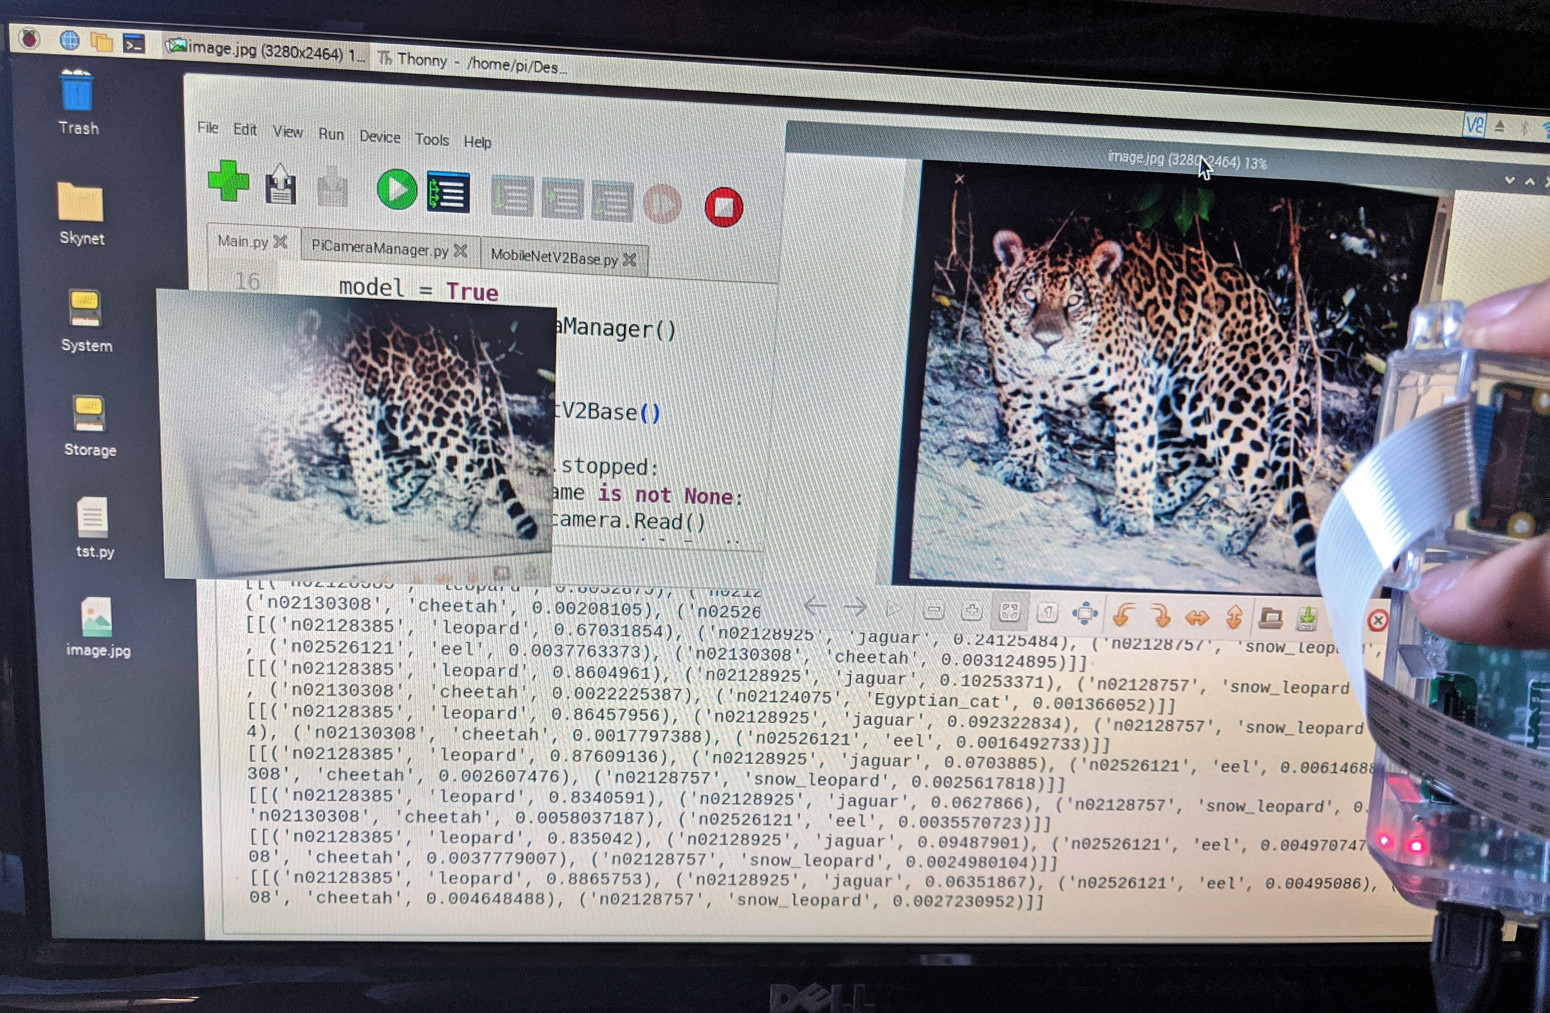
Overview
Project Introduction
Raspberry Pi Setup (SD and OS)
Camera and API
TensorFlow v2 on ARM
MobileNetV2
Code and Demo
Future Projects
Conclusion

Slide 7
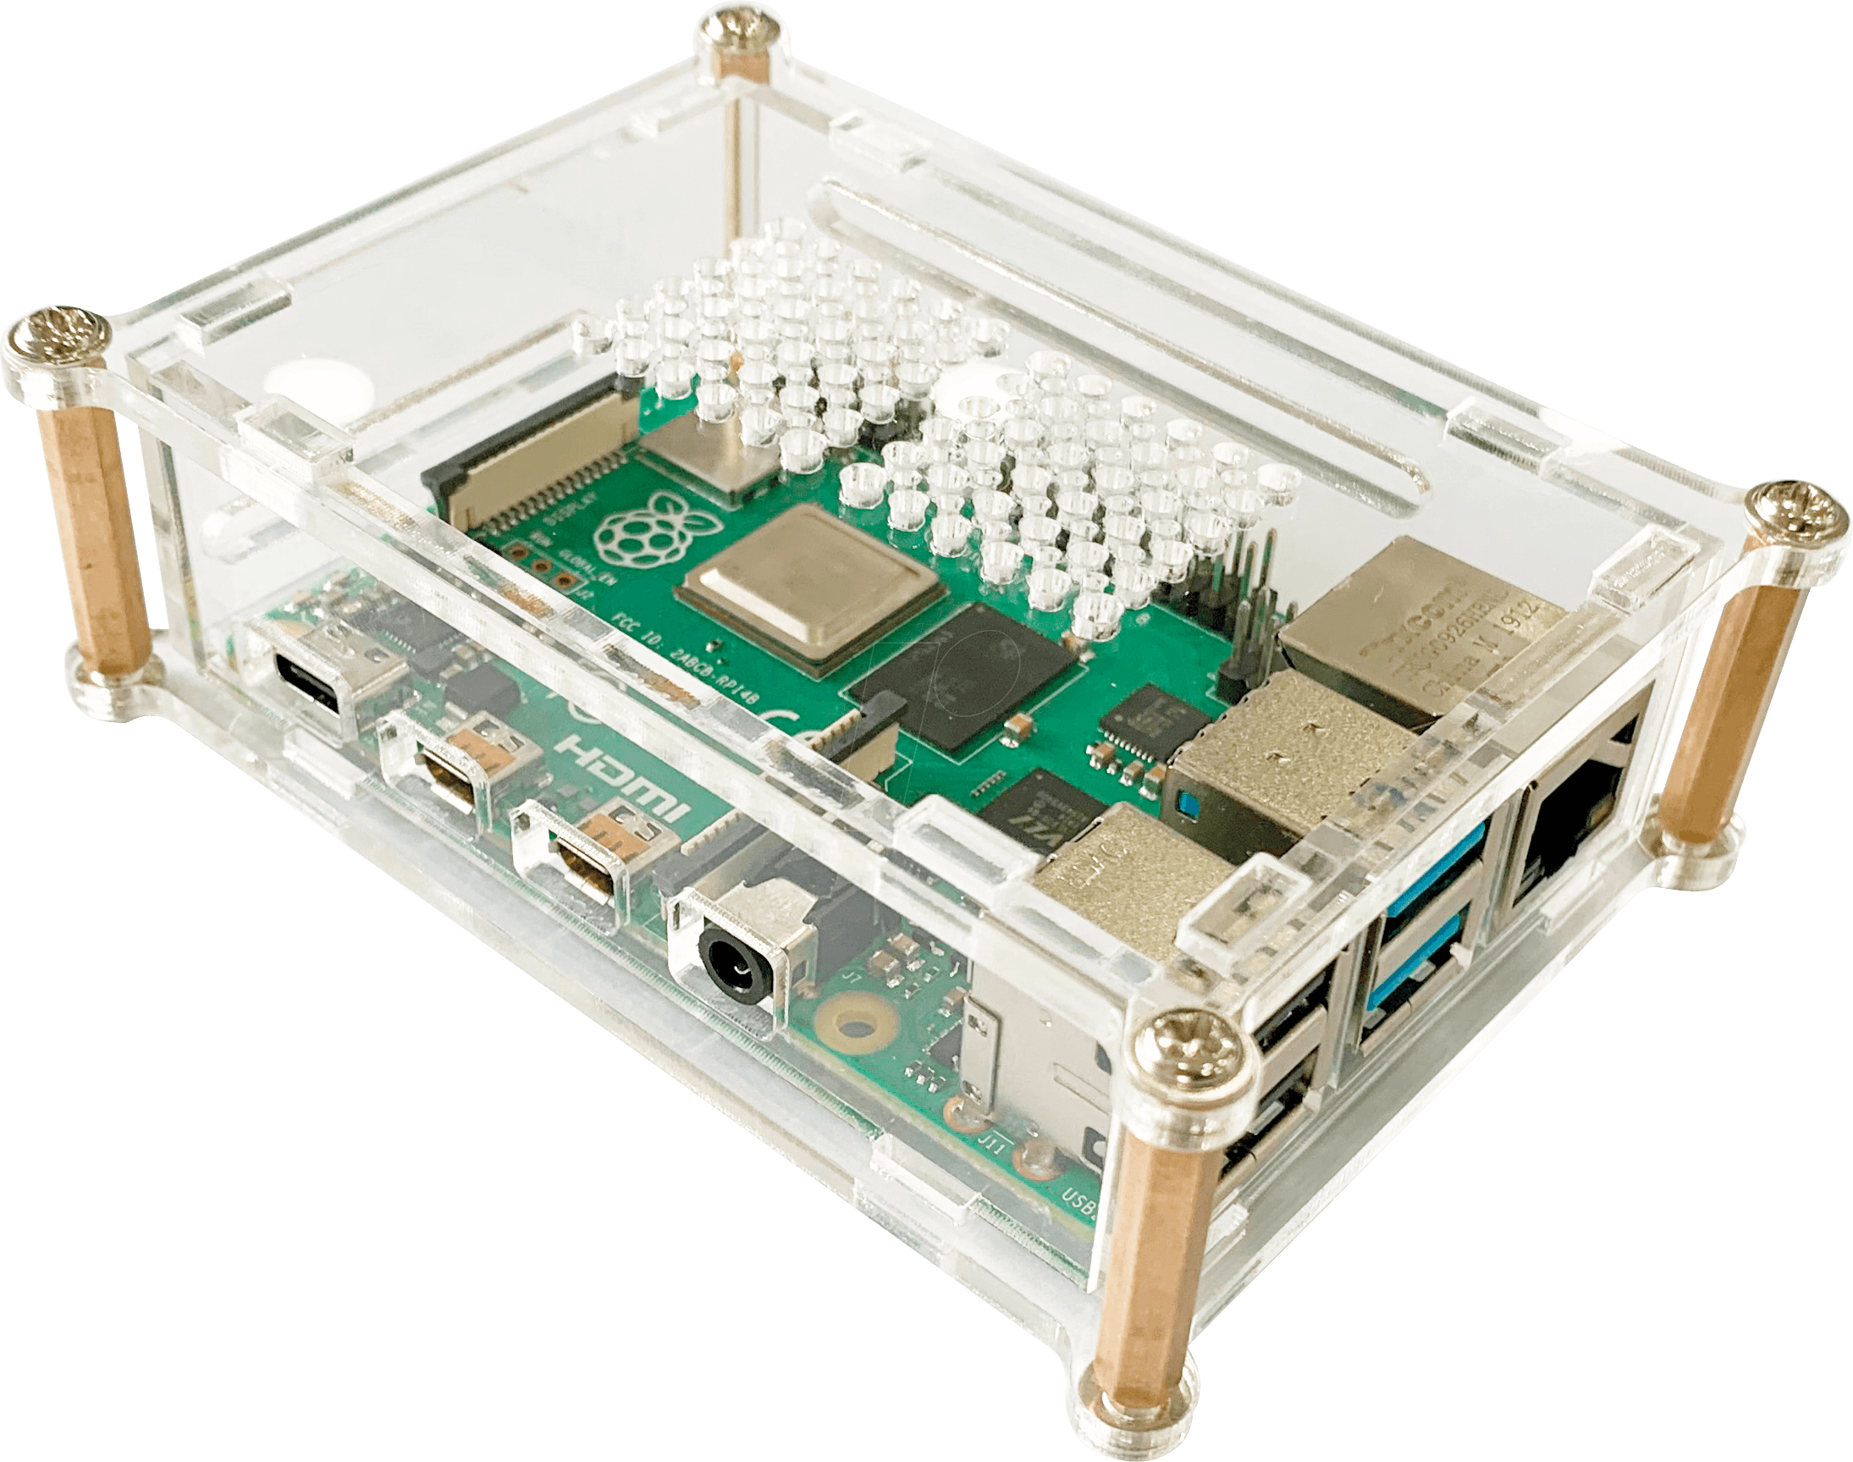
Project Introduction
Raspberry Pi 3
Raspbian (Now Raspberry Pi OS)
Raspberry Pi Camera Module V2-8 Megapixel
Leigh Johnson (@grepLeigh)

Slide 8
Raspberry Pi Setup (SD, OS, Camera)
SD Card
>= 8GB
Raspberry Pi Imager (I used Windows)
Don’t:
> 32GB
Write protect your card
Raspberry Pi OS (Former Raspbian) or Noobs

Slide 9
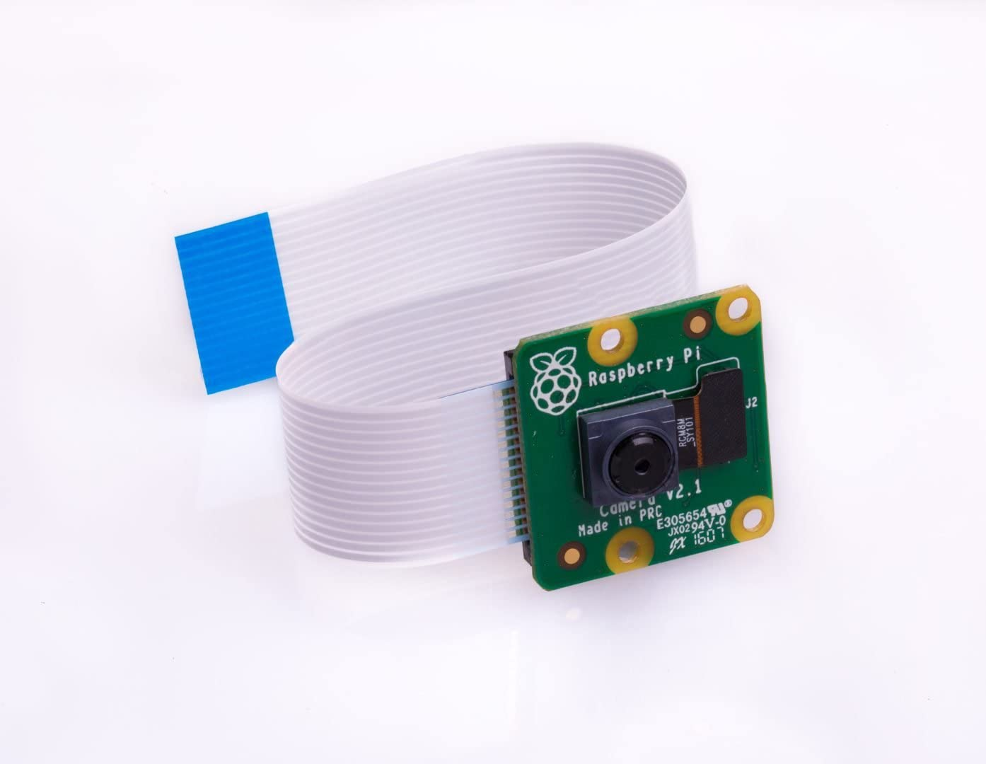
Camera and API
Camera: V2 8 Megapixel
API: PiCamera
sudo apt install python3-picamera

Slide 10
TensorFlow v2 on ARM
TensorFlow v2 doesn’t support ARM
TensorFlow Lite is preferred going forward
I use this on my Android application and it is pretty smooth
TensorFlow 2 ARM WHL: https://github.com/lhelontra/tensorflow-on-arm/releases

Slide 11
MobileNetV2
Built into Keras
tensorflow.keras.application.mobilenet_v2
Version 3 is out

Slide 12
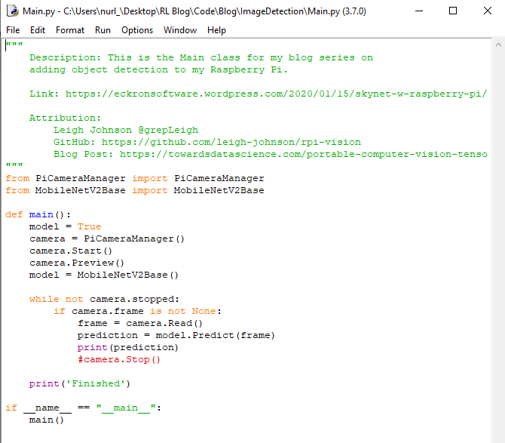
Main

Slide 13
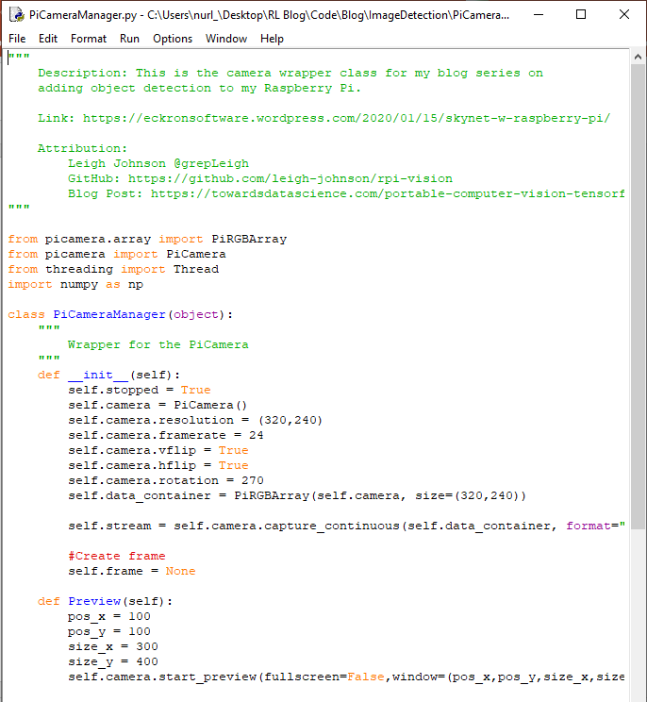
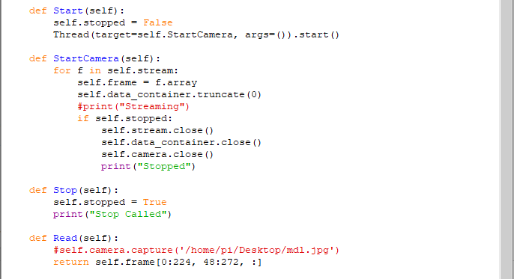
PiCamera Wrapper

Slide 14
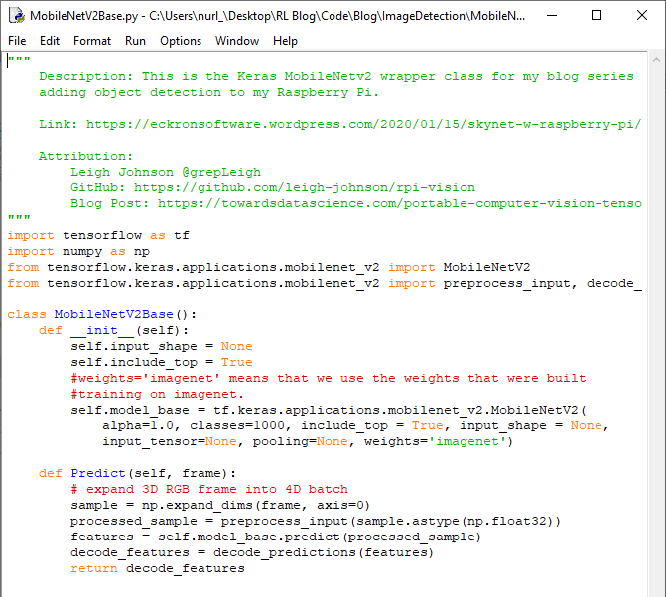
MobileNetV2 Wrapper

Slide 15
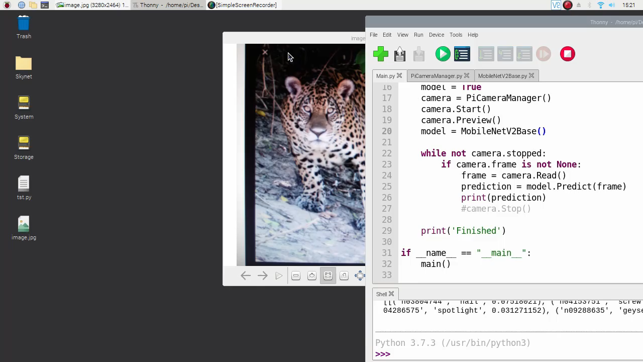
Demo

Slide 16
Future Projects
Lock weights and train on a subset of images
Family pictures, cars, etc.
Implement object tracking for security cameras
Add to an automated home to turn the lights on when you show up
Really dumb but someone online added a Pi to his clock so that if anyone was looking at the clock it would jump off the wall
Anything…

Slide 17
Conclusion
Simple (Pretrained model, easy installs, and quick results)
Cheap ($35 Pi, $30 camera, $ SD card)
Easy (I was able to do it)

Slide 18
Links
Leigh Johnson’s Project: https://towardsdatascience.com/portable-computer-vision-tensorflow-2-0-on-a-raspberry-pi-part-1-of-2-84e318798ce9
Camera Api: https://picamera.readthedocs.io/en/release-1.13/
TensorFlow 2 ARM WHL: https://github.com/lhelontra/tensorflow-on-arm/releases
MobileNetV2 Paper: https://arxiv.org/abs/1801.04381
Code Repository: https://github.com/ehennis/Blog/tree/master/ImageDetection

Slide 19
My Information
Twitter: @TheNurl
GitHub: https://github.com/ehennis
YouTube: Evan Hennis
Blog: http://blog.eckronsoftware.com
Email: EvanHennis@gmail.com
Manning liveProject: ???

